Slide 1
404
Brain
Not Found
Subscription-Based E-Commerce Web Application

Slide 2
Team Members
M H Jaswanth
Aishwarya Basu
Sriya Rallabandi
Sampriti Thummala
Nihar Tokachichu
Sidharth Chandra Siramdas
Chakrakoti Jyothi Manikanta Swaroop

Slide 3
Objective
Develop a subscription-based e-commerce web application for food products.
Enable customers to subscribe to products and receive them on a recurring basis.
Provide access to essential food items like organic fruits, vegetables, snacks, and ready-to-eat meals.
Offer flexible subscription plans: daily, weekly, bi-weekly, and monthly deliveries.

Slide 4
Key Features
Subscription Management:
Multiple plans for flexible subscriptions.
Product Management:
Admins manage product additions and updates.
Order Management:
Customers place orders; admins manage delivery.
Delivery Scheduling:
Timely deliveries based on subscriptions.
Discounts:
Special offers for frequent subscriptions.

Slide 5
Technology Stack
Java
MySQL
For scalable server-side applications.
For reliable data management.
SQL JDBC
HTML, CSS, JavaScript
Connects Java and MySQL.
HTML, CSS, JavaScript for responsive interfaces.

Slide 6
Database Schema
1
2
3
4
4
5
6
Customer
Product
Subscription
Orders
Stores customer information.
Contains product details.
Manages subscription types.
Logs order information.
Order History
Order Item
Delivery
Schedule
Tracks past orders.
Details each order’s items.
Manages delivery timings.

Slide 7
Application Overview
ER Diagram
Use Case Diagram
Data relationships and structure.
Functional user interactions overview.
Layered Architecture
Class Diagram
Major classes and their relationships.
Modular design with separation.

Slide 8
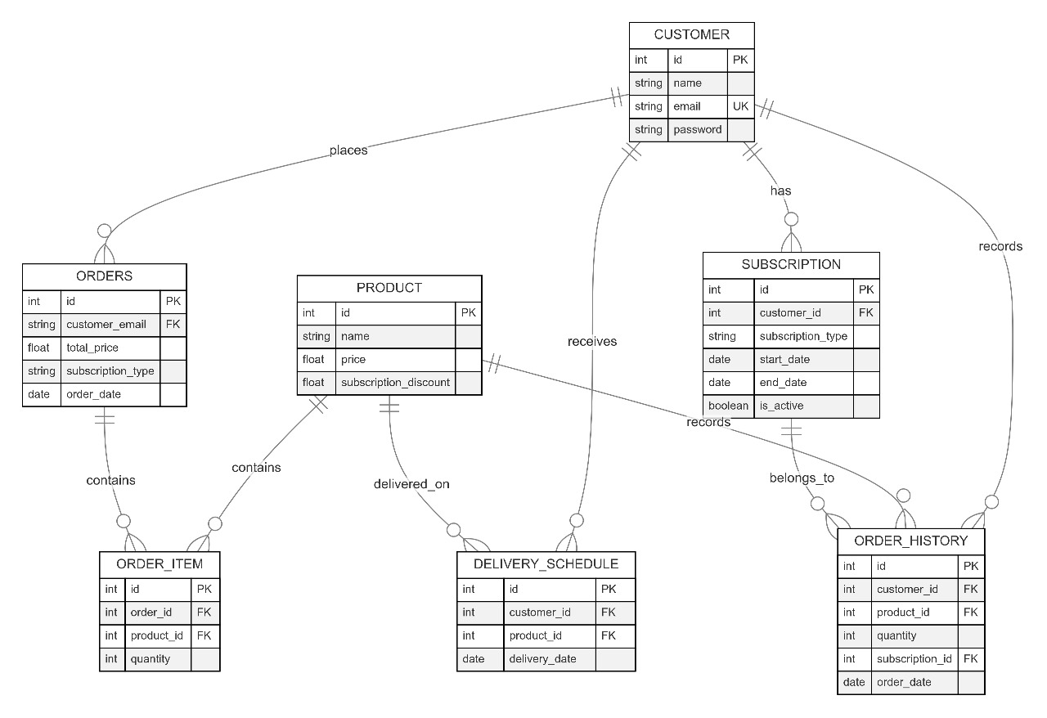
ER Diagram

Slide 9
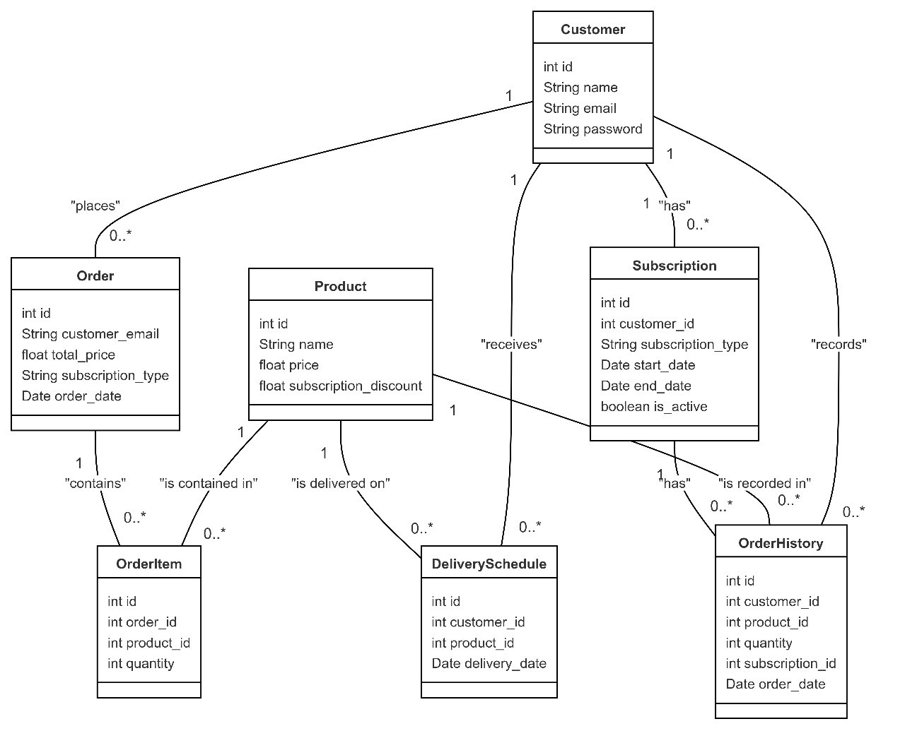
Class Diagram

Slide 10
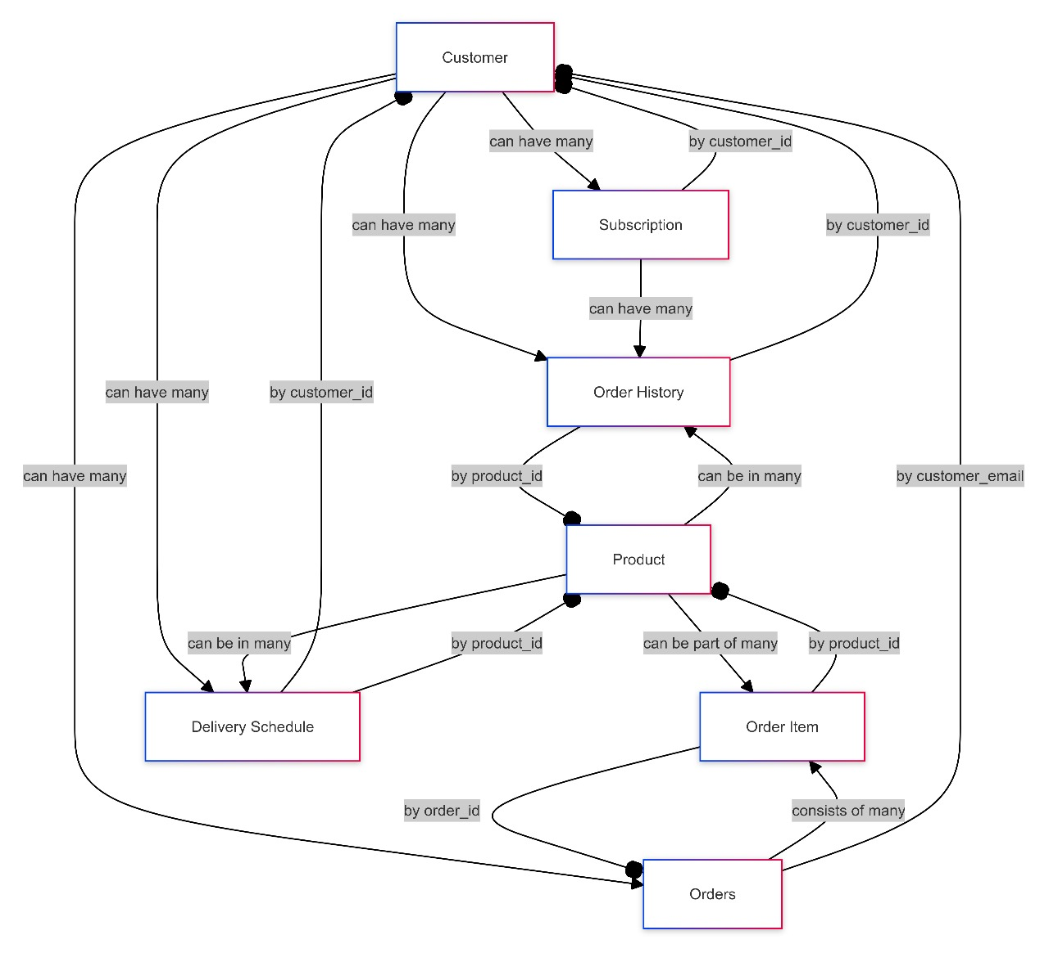
Use - Case Diagram

Slide 11
Layered Architecture
Presentation Layer:
Manages user interactions and interface logic.
Service Layer:
Contains business logic and processes data between presentation and data access layers.
Data Access Layer (DAO):
Handles CRUD operations and data integrity with DAO classes.
Database Layer:
Stores application data in MySQL, including customers, products, and orders.

Slide 12
Collaboration and Tools

Slide 13
Database Schema
1
2
3
IDE Used
Version Control
Collaboration Tools
IntelliJ IDEA for efficient development and debugging.
GitHub for version tracking and collaborative coding.
Slack for team communication, Trello for project tracking.

Slide 14
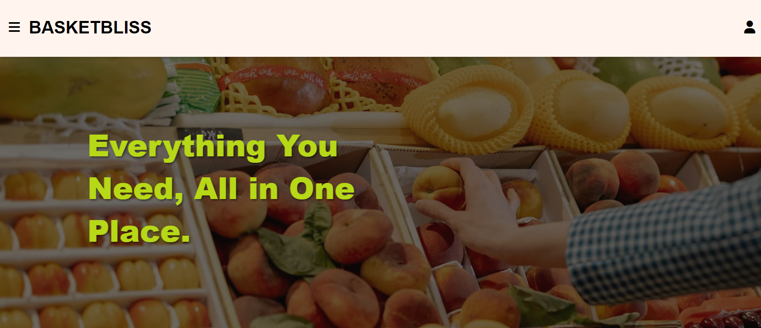
UI Design & Frontend
Crafting Intuitive and Engaging User Interfaces

Slide 15
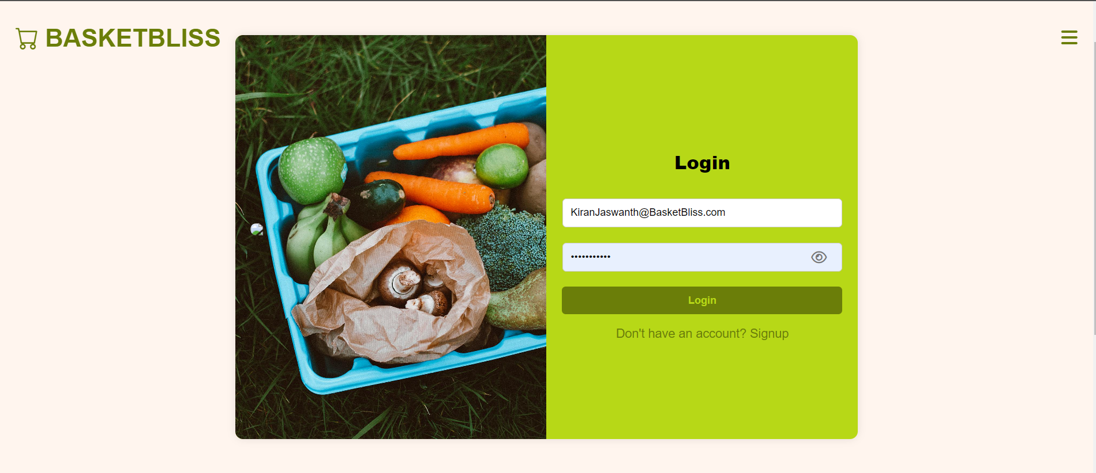
Login

Slide 16
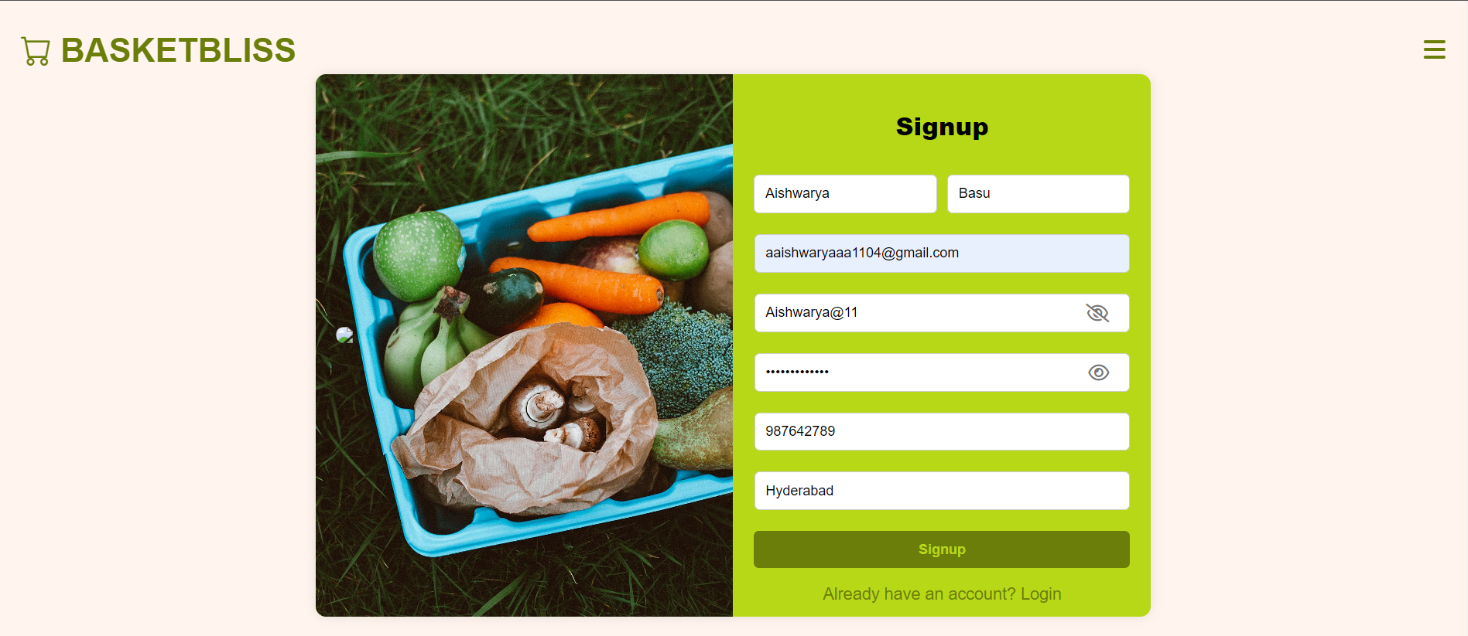
Sign-Up

Slide 17
DashBoard

Slide 18
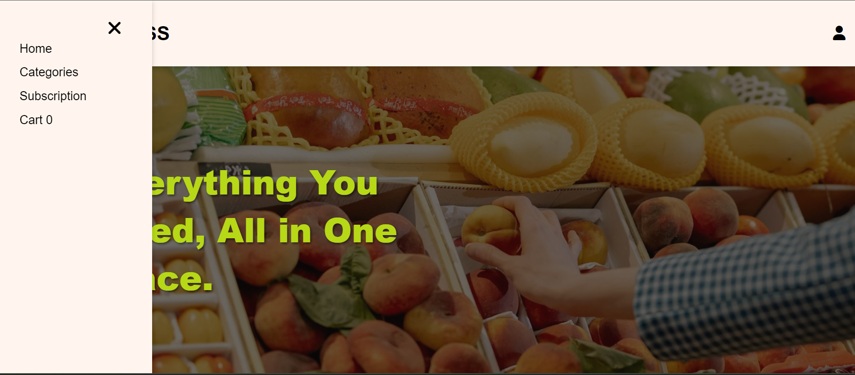
DashBoard Sliding Navbar

Slide 19
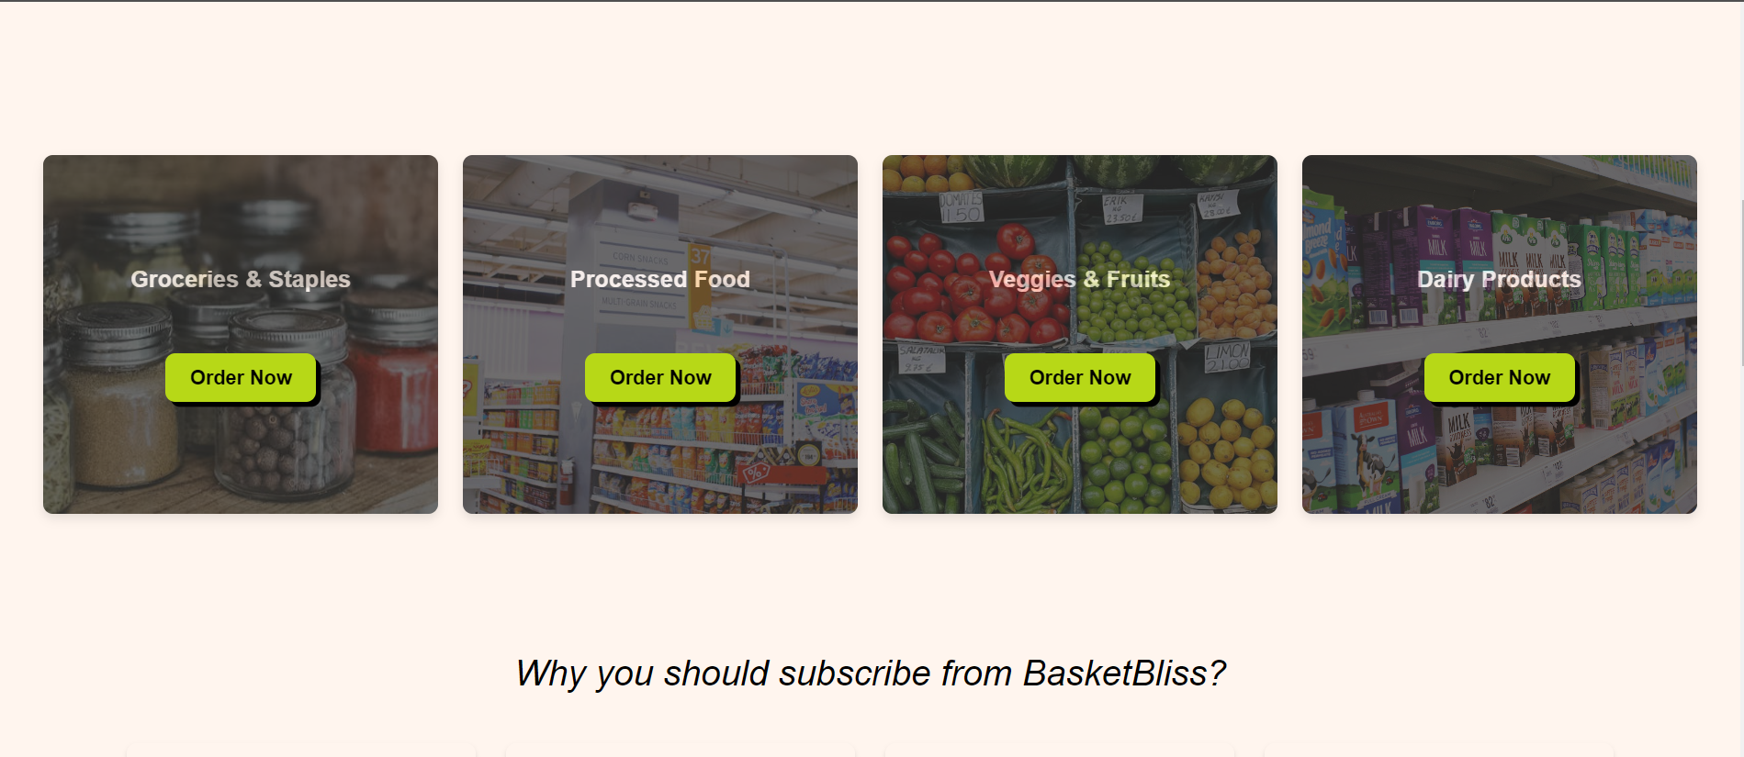
Categories

Slide 20
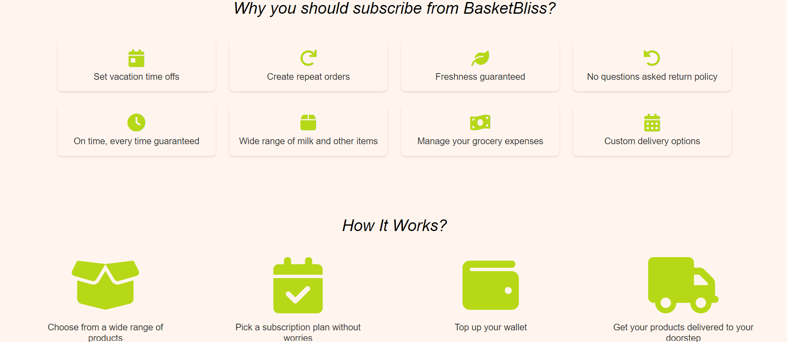
Additional Information

Slide 21
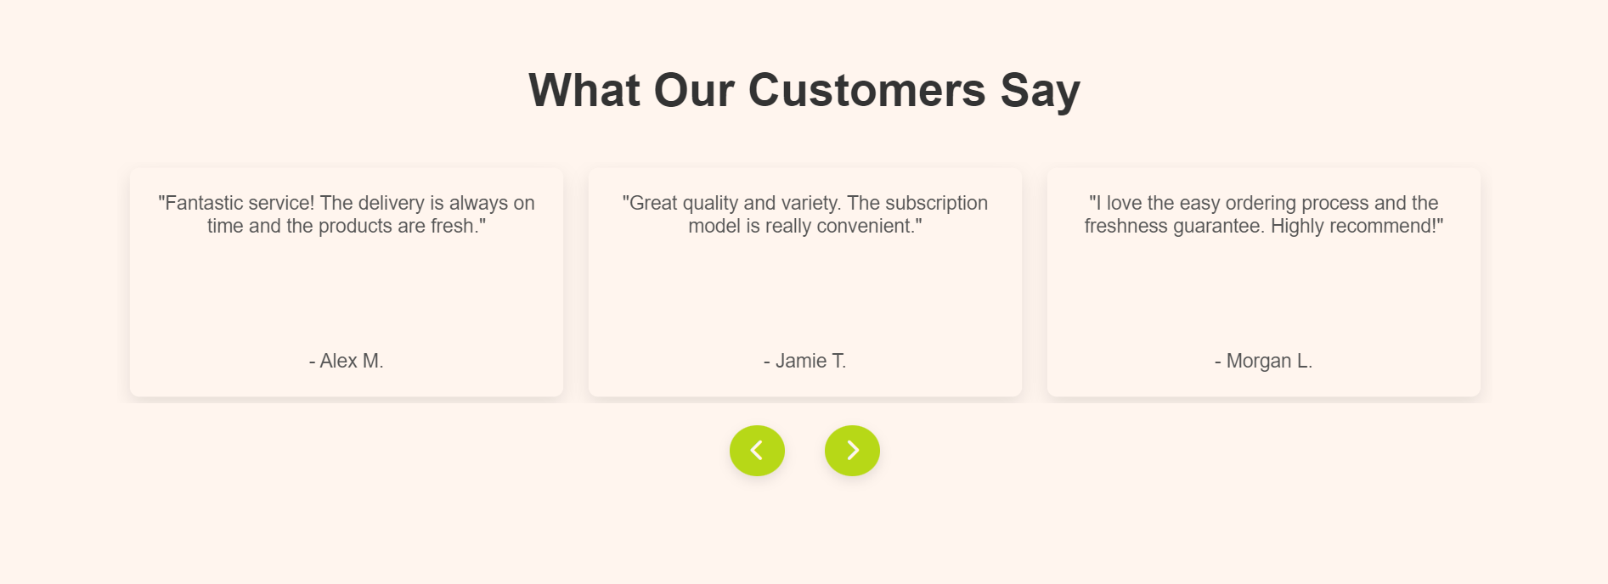
Customer Reviews

Slide 22
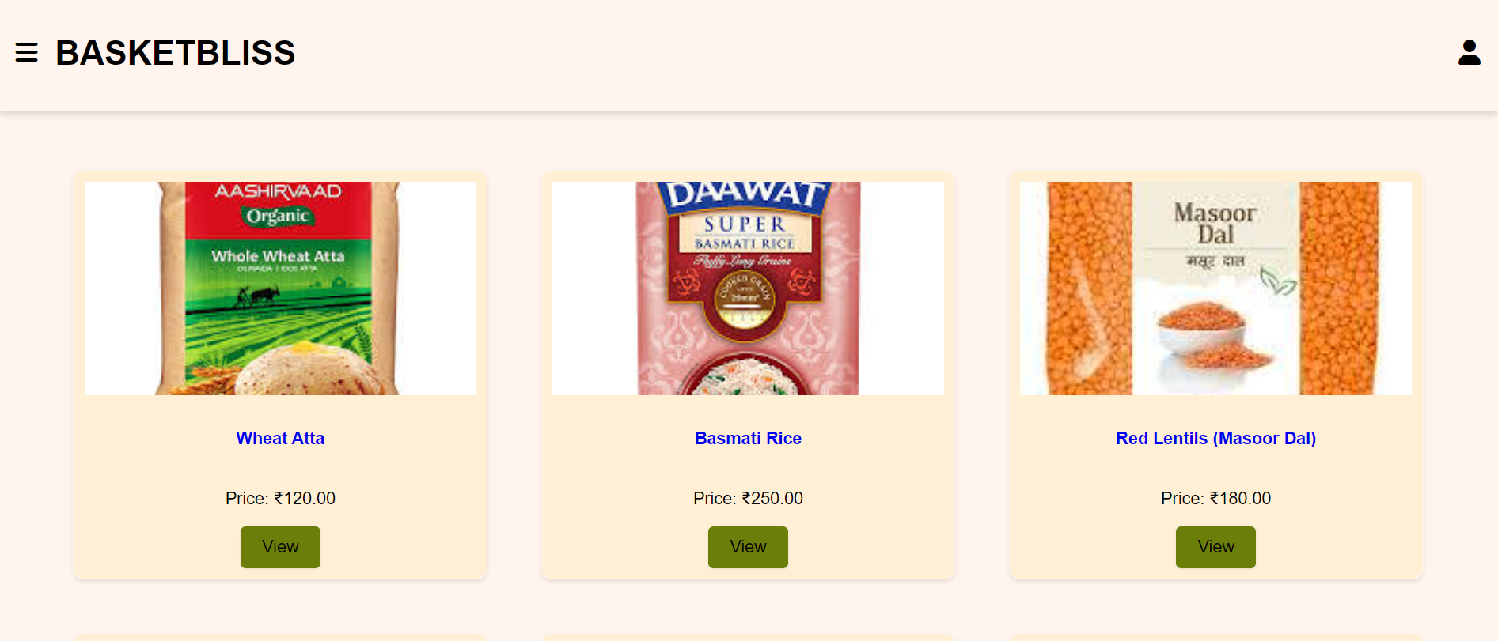
Product Listing

Slide 23
Admin Capabilities Overview
A
C
Manage Products
Edit Subscriptions
A
Perform CRUD operations on products.
Modify user subscription details.
?
B
B
D
Delete Subscriptions
Oversee Updates
C
D
Remove user subscriptions.
Ensure accurate subscription changes.

Slide 24
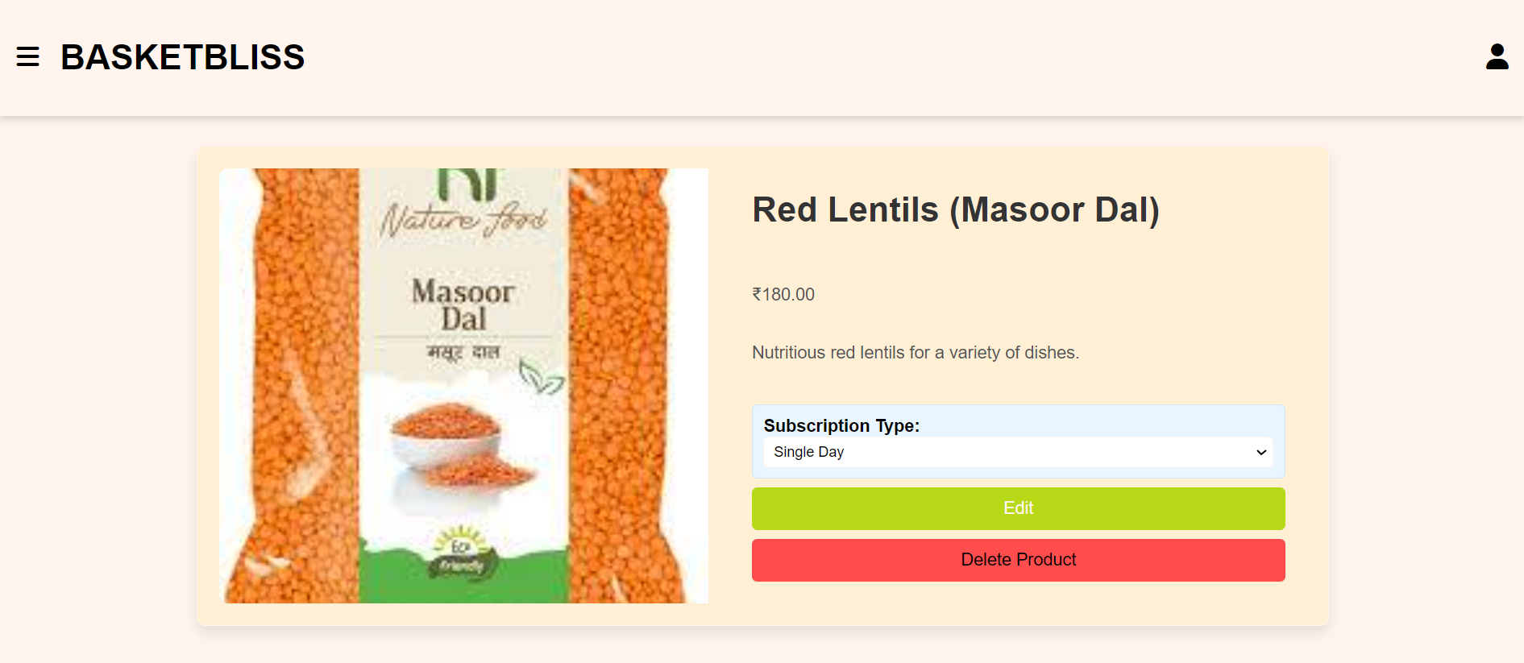
Admin Panel: Edit Product Information

Slide 25
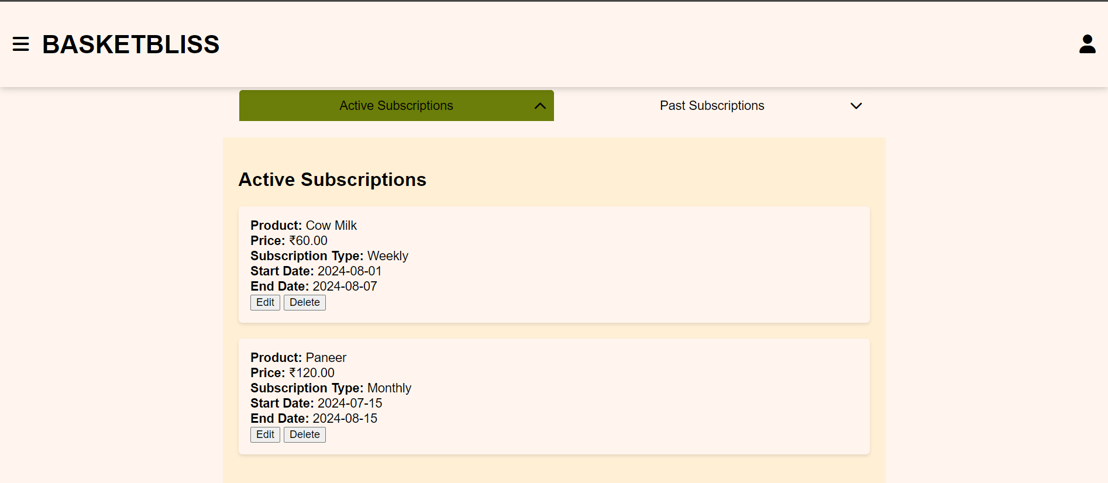
Admin Panel: Edit Subscription Details

Slide 26
Customer Panel?

Slide 27
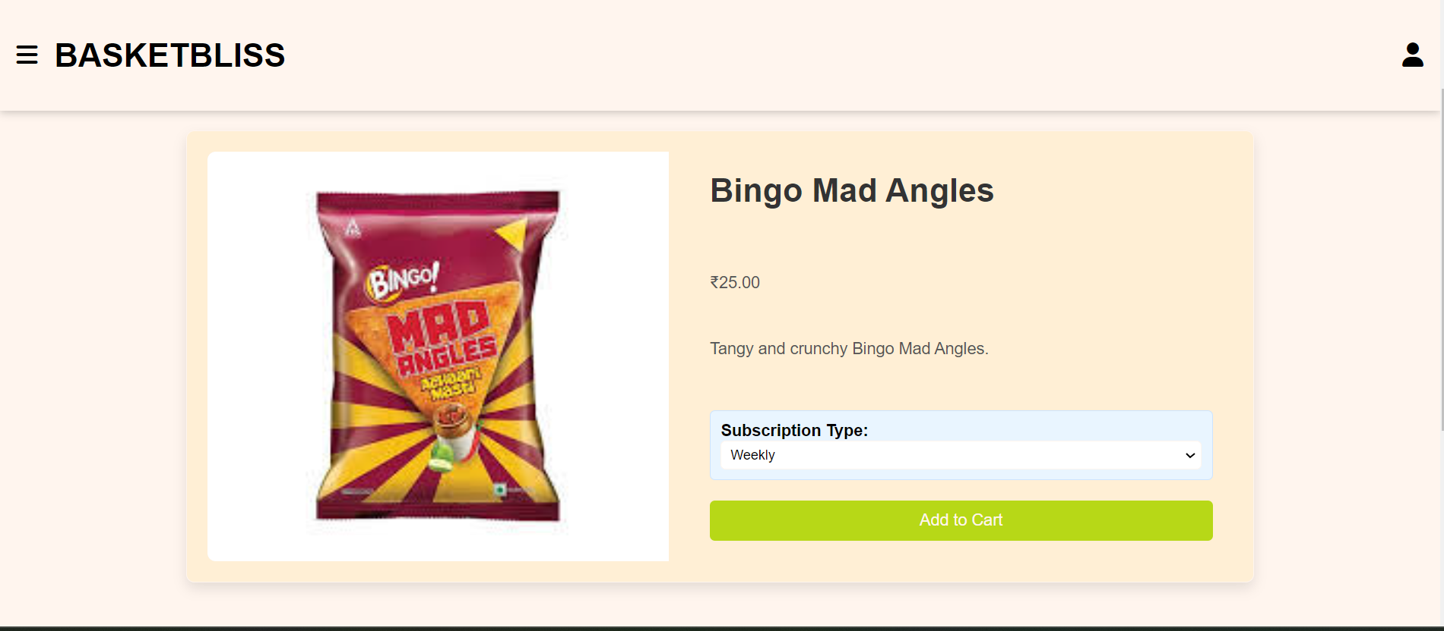
Product Tab: Add to Cart

Slide 28
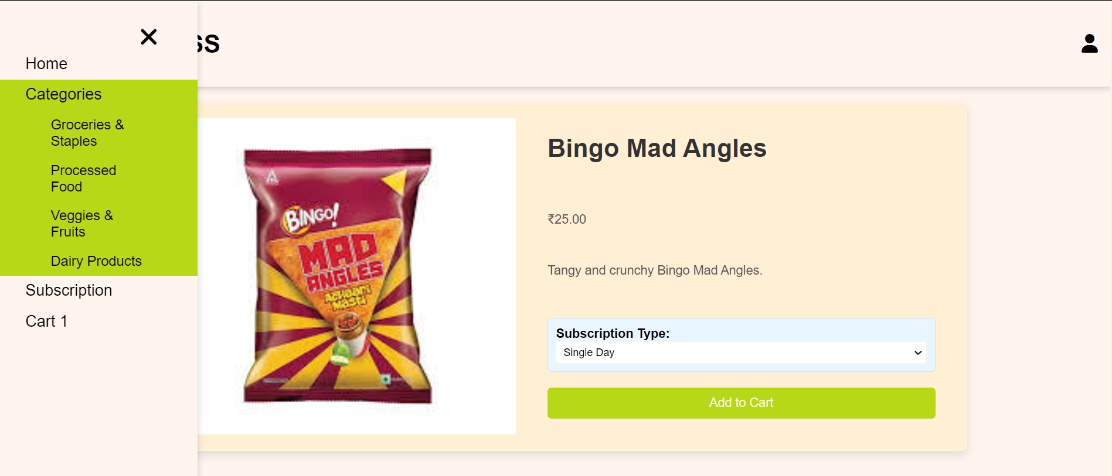
Cart Update: Product Added

Slide 29
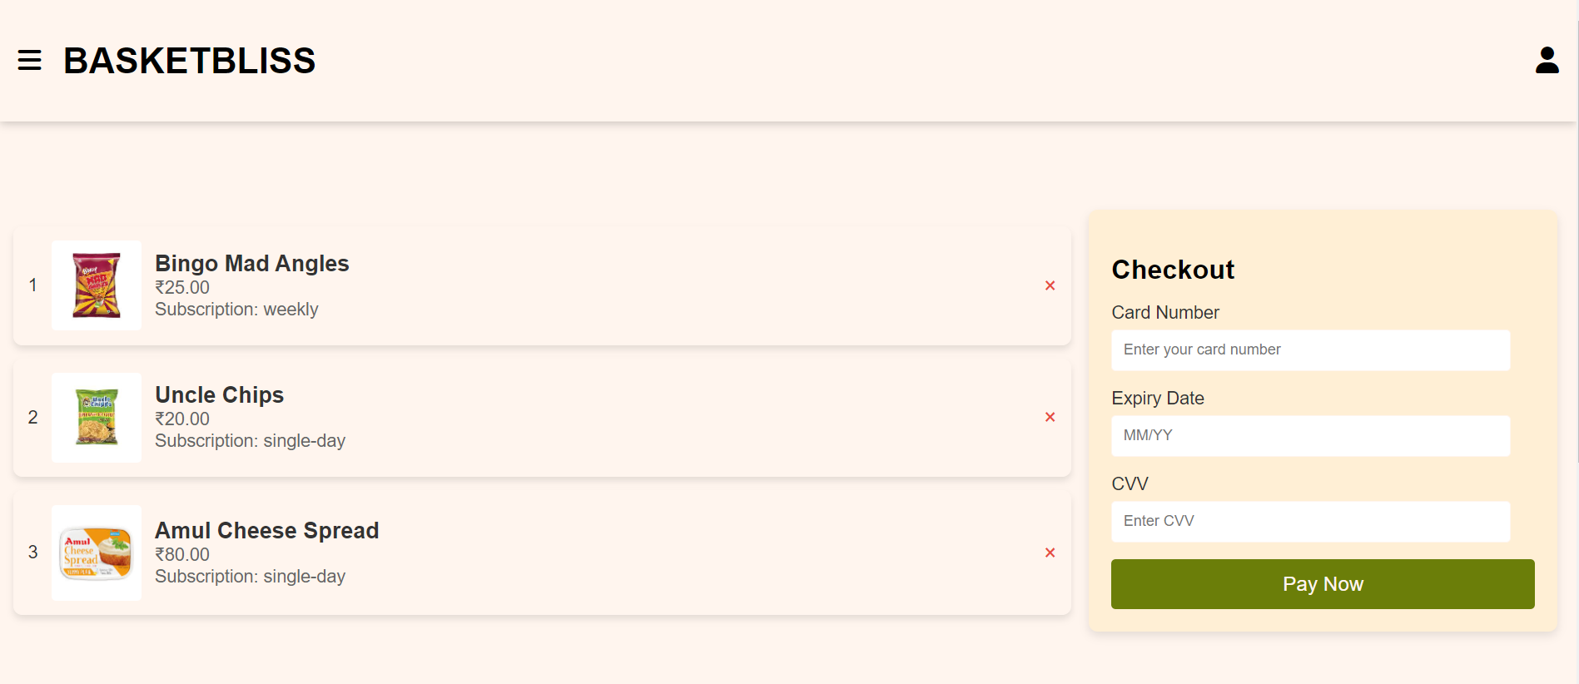
Customer Cart : View and Manage

Slide 30
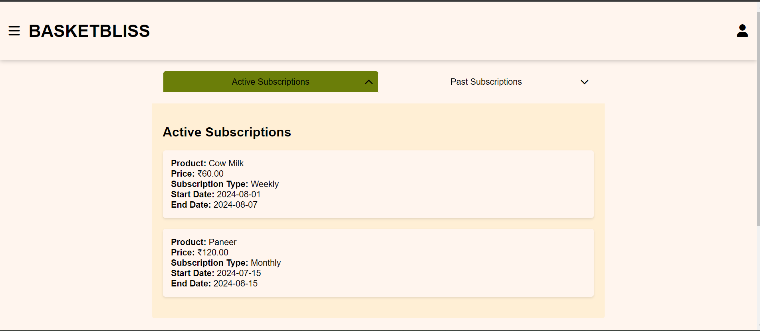
Customer Subscription

Slide 31
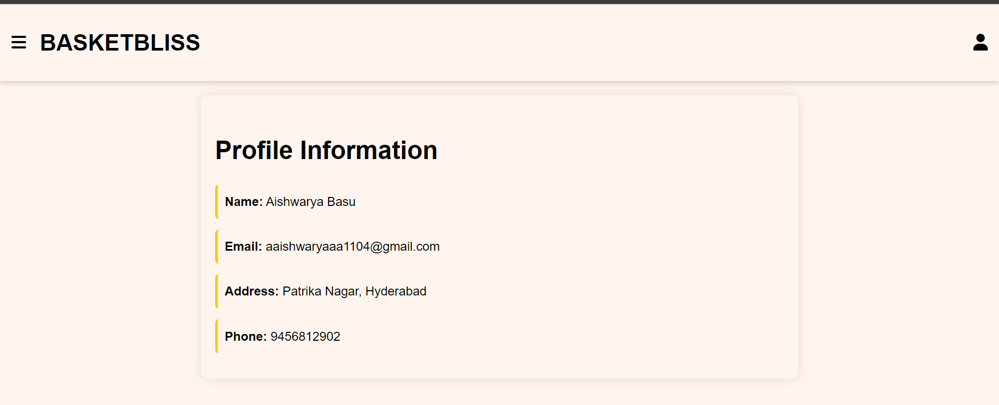
Profile Information

Slide 32
Future Enhancements
1
3
2
4
Enhanced Web Interface
Advanced Analytics
Improve design for better usability
Use data to understand trends.
Expanded Subscription Options
Advanced Product Management:
Add more flexible subscription plans.
Bulk edit and advanced filtering.

Slide 33
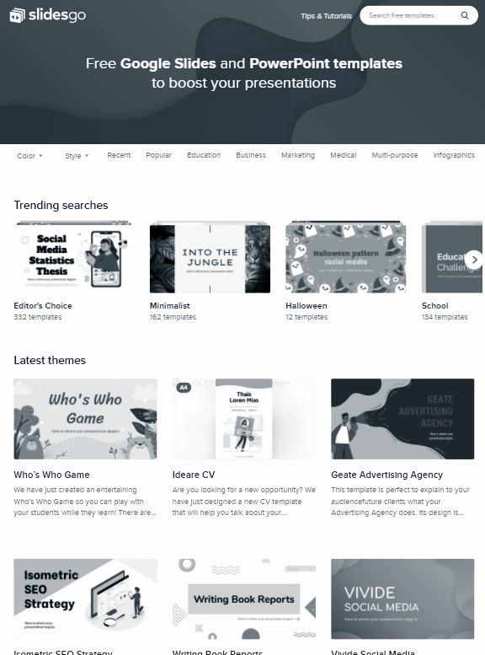
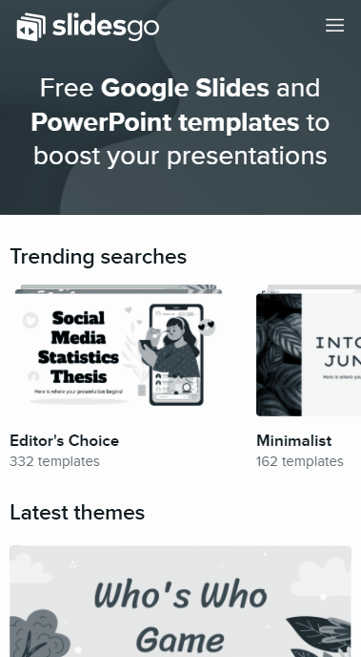
Future Enhancements: Mobile Application
In the future, we plan to develop a mobile application to enhance user accessibility and convenience. This will allow users to manage their shopping, subscriptions, and orders from their smartphones, improving engagement and expanding our reach.

Slide 34
Scalability
Ensure efficient handling of increased traffic and data through optimized performance and cloud solutions.

Slide 35
Scalability
Performance Optimization
Cloud Solution
Load Balancing
Speed and responsiveness enhancement.
Flexible, scalable cloud resources.
Even traffic distribution.
Modular Architecture:
Database Scaling
Auto-
Scaling
Easy component upgrades.
Expand database capacity.
Dynamic resource adjustment.

Slide 36
Challenges and Solutions
Challenges
Solutions
Implemented a robust subscription management system and optimized discount algorithms. Utilized data validation techniques and streamlined user interfaces to enhance overall functionality and consistency.
We encountered issues with managing diverse subscription types and applying dynamic discounts. Ensuring data consistency and user experience across various scenarios also posed difficulties.

Slide 37
Conclusion
We’ve successfully developed a comprehensive grocery eCommerce platform, featuring robust subscription and product management capabilities. Our project addresses key user needs and incorporates advanced functionalities.

Slide 38
Thanks!
GitHub Repository:
https://github.com/jsvnthkiran/Subscription-Based-ECommerce-Application
https://github.com/jsvnthkiran/Subscription-Based-ECommerce-Application
Please keep this slide for attribution

